Slide 1

Al Futtaim Automotive - November 23rd 2023

Slide 2
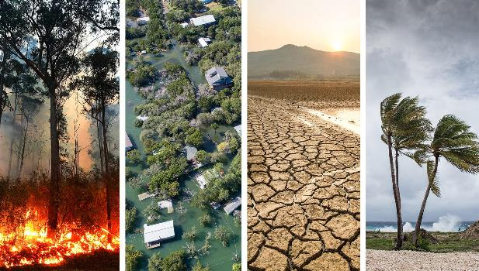

Why this workshop
Climate change is amplifying.
Taking action is urgent!

Slide 3
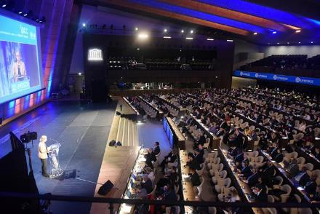
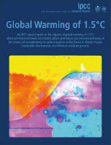
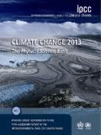

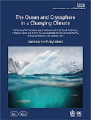
Intergovernmental Panel on Climate Change
195 governments
300 of scientists
Tens of thousands of research papers
Unanimous agreement on
the known facts,
the probability of their consequences and
the mitigation actions
1988: Creation of the IPCC by the United Nations
2007: Nobel Peace Prize winner
2022: 6th Assessment Report

Slide 4

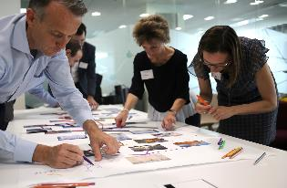
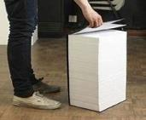
Understand climate change
2 options
or
Read
The IPCC report
3068 pages
Play
The Climate Fresk
3 hours

Slide 5
Confucius
I hear and I forget.
I see and I remember.
I do and I understand.

Slide 6
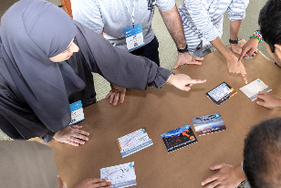
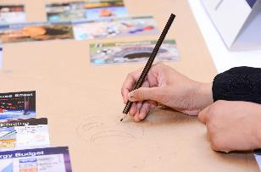
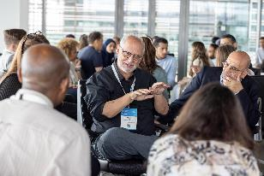
A 3-hour workshop
Diagnostic
80 min
Defining cause-effect relationships between the 42 cards to create a collage
Anchorage
20 min
Taking ownership of the collage by personalising it and giving it a title
Solutions
80 min
Debriefing and discussion on concrete solutions at individual and organisational levels
Notes:
rajouter photo Fresque

Slide 7
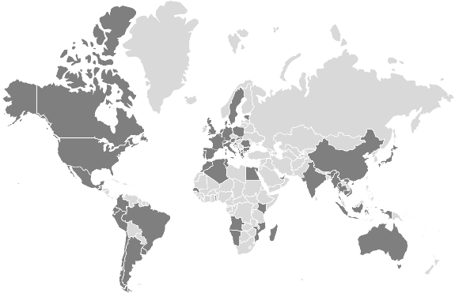
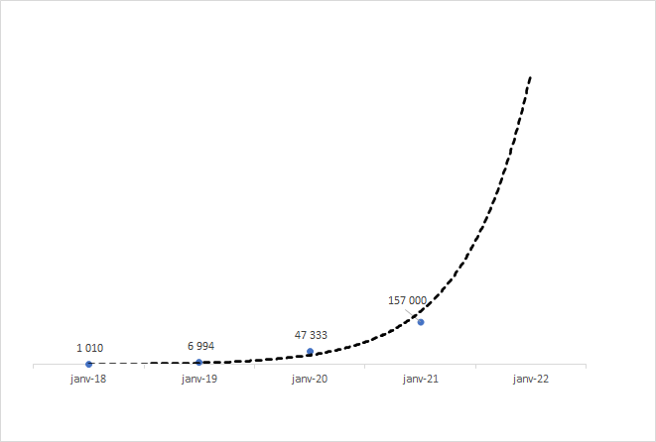
The Climate Fresk Community
45 languages
130 countries
1,200,000 participants
60,000 facilitators
COP28 in UAE
1 000 000
x7
x3
x7
x7
number of participants
2018
2019
2020
2021
2022

Slide 8














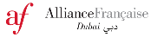































They played in the UAE
Companies
Educational Institutions
Other organisations
+ 2 leading luxury brands

Slide 9
Our company
Cool Down CSR Initiatives Preparation LLC
To avoid global warming,
we all need to cool down

Slide 10
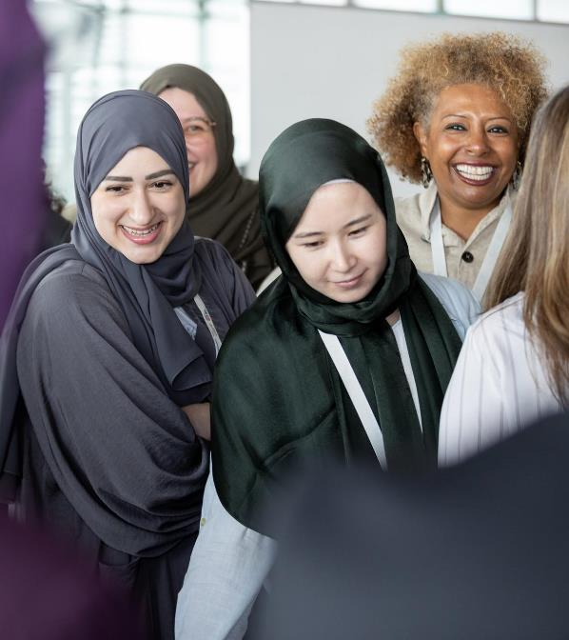
Collective intelligence
Have fun
Listen to each other
Ask questions

Slide 11
Climate?
Climate vs Weather

Slide 12
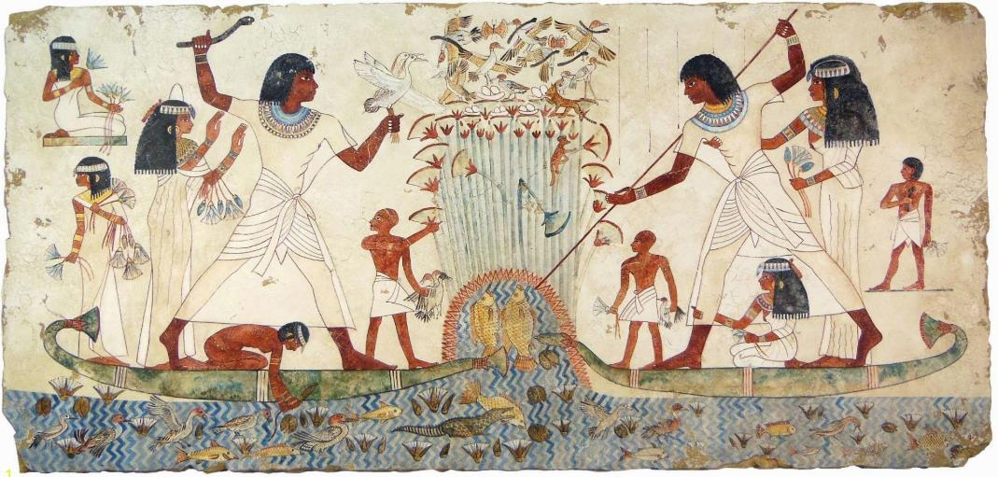
Fresk?

Slide 13
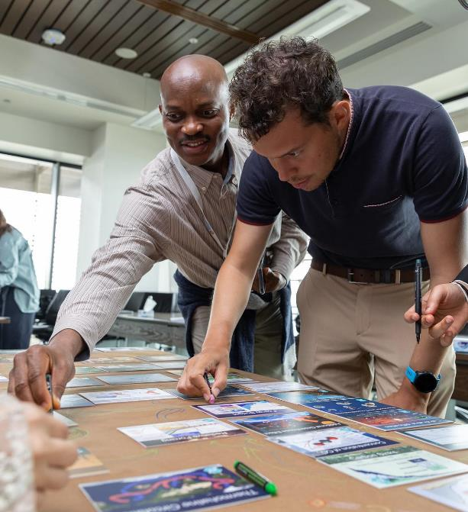
Ready?!
Let’s fresk!

Slide 14
Ice breaker
How much do you know about the causes and consequences of climate change?
1 - very little 5 - IPCC level

Slide 15
Ice breaker
What do you love doing?

Slide 16
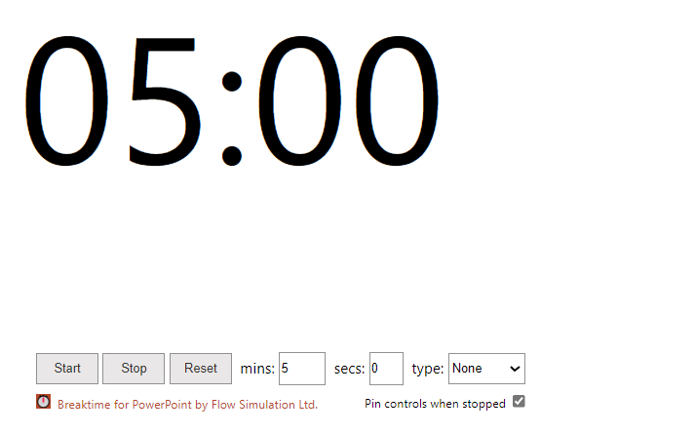
Set 1

Slide 17
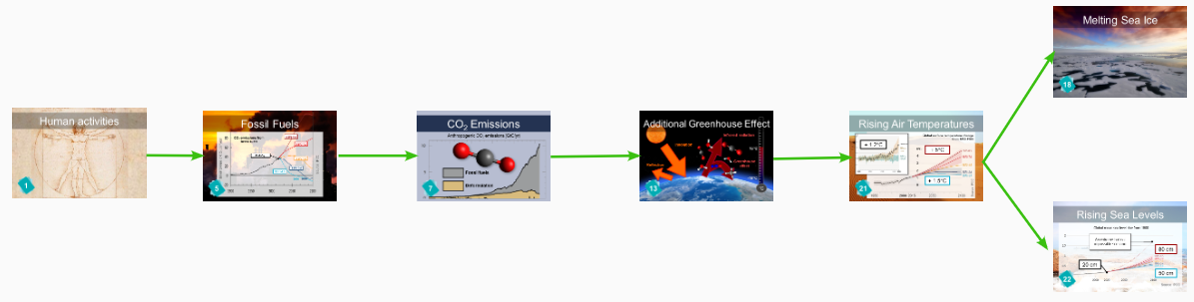
Set 1

Slide 18
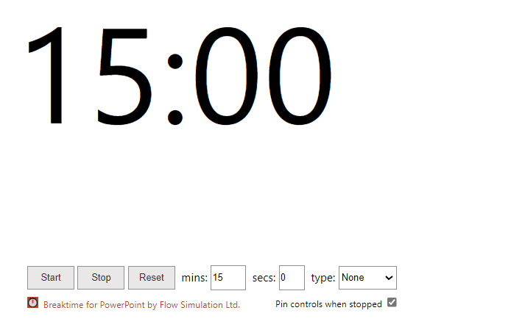
Set 2

Slide 19
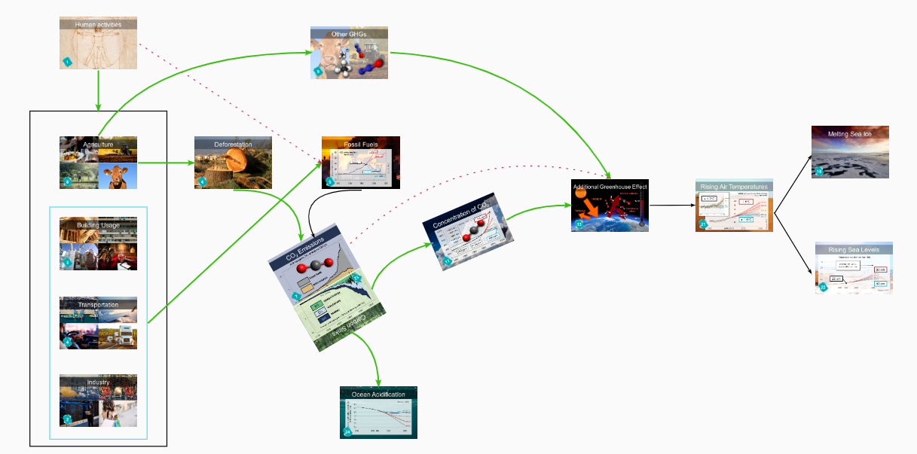
Set 2

Slide 20
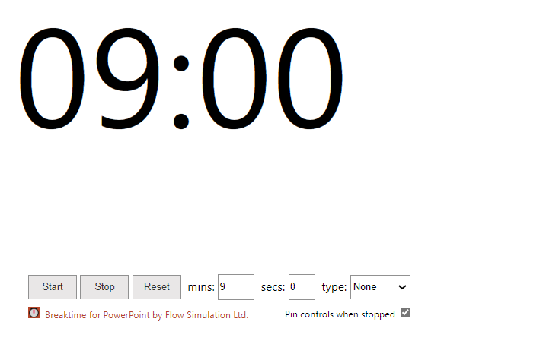
Set 3

Slide 21
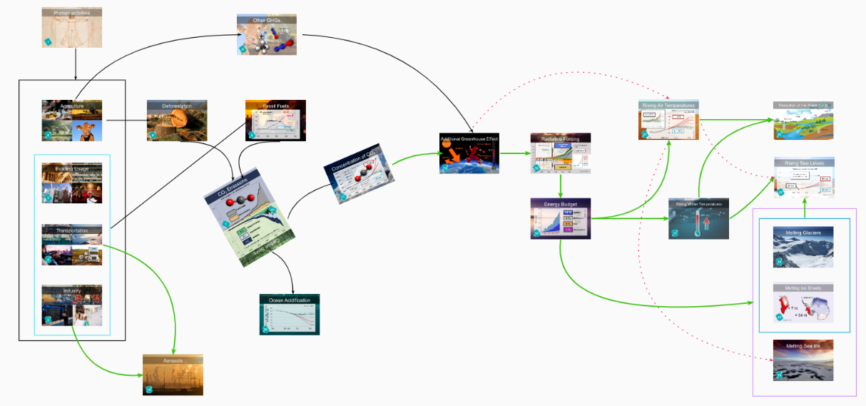
Set 3

Slide 22
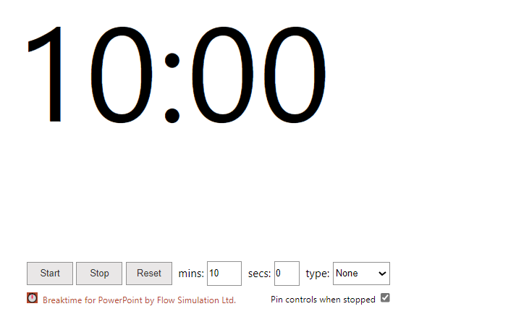
Set 4

Slide 23
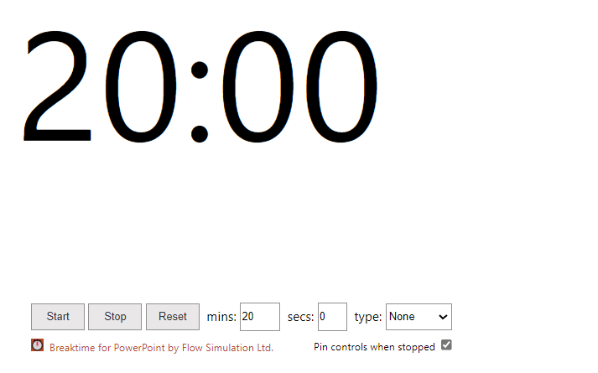
Set 5 & Creativity

Slide 24
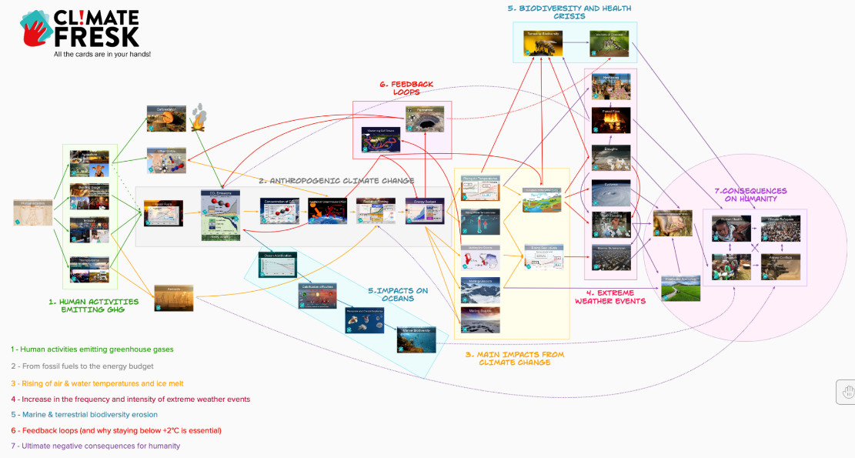
Climate Fresk
We can group related cards
into large categories:

Slide 25
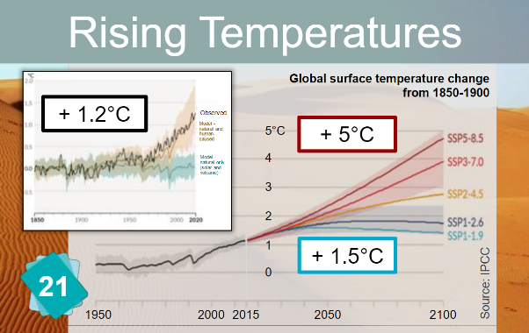
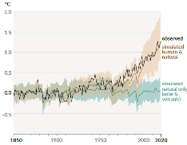
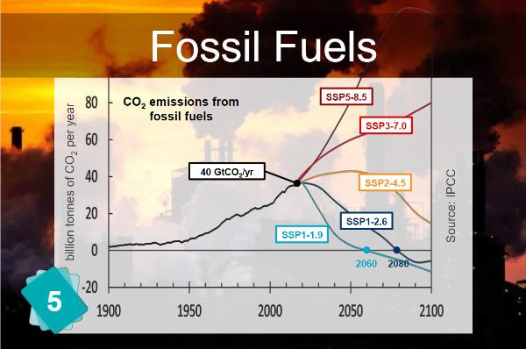
A systemic transformation
+1.2°C
6% reduction of fossil fuel consumption per year from 2020 to 2060
Notes:
25

Slide 26
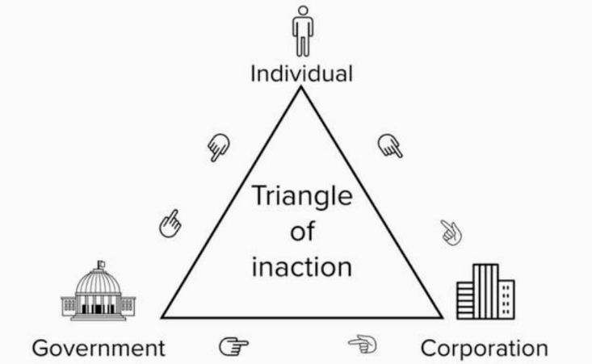
Triangle of inaction
Notes:
26

Slide 27
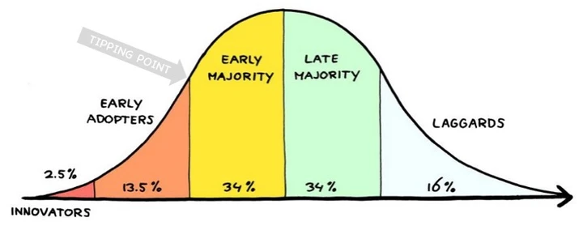
Law of diffusion of innovation
Notes:
27

Slide 28
Solution = Action
Why are there no solutions cards?

Slide 29
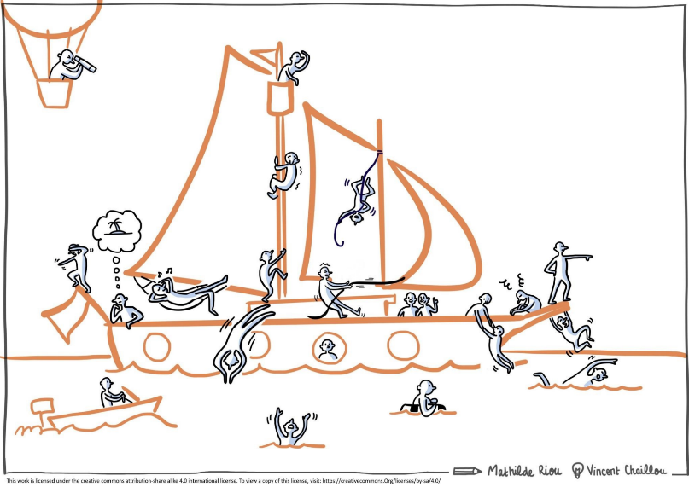
Internal weather
Looking at the consequences of climate change,
what emotion do you feel most?
Sad
Surprised
Joyful
Disgusted
Angry
Afraid

Slide 30
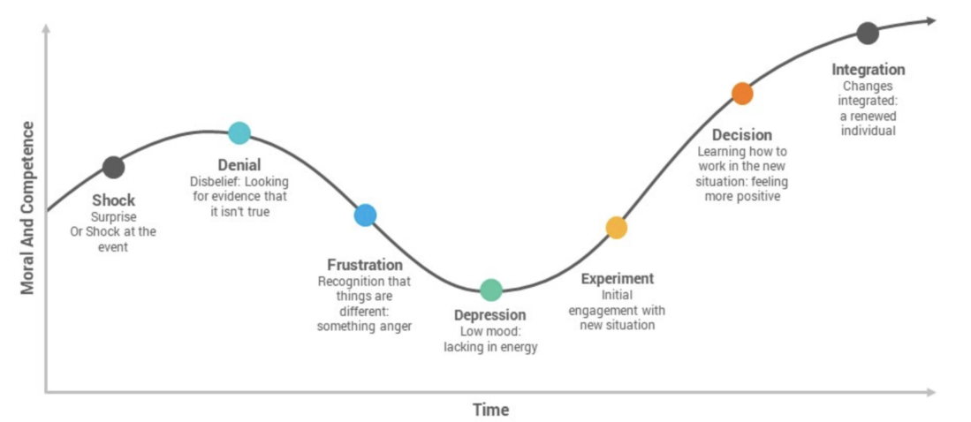
Kübler-Ross Grief Cycle
Emotions are natural… and useful
Notes:
Pas de transformation sans passage par des émotions fortement déplaisantes.

Slide 31
Question
?
What is the only way to overcome eco-anxiety?
Take action
You’ll feel better… and more optimistic!

Slide 32
Key question for individuals
What do you love doing
that does not emit CO2?
⇒ increase fulfillment AND decrease footprint

Slide 33
Harvard’s study
Longest study on happiness found that the #1 factor of health and happiness is…
the quality of our relationships

Slide 34
Key actions for each human activity
Industry
Agriculture
Buy less (think twice before you buy)
Buy better (local, good quality)
Prefer 2nd hand or eco-friendly
Waste less
Eat less (red) meat
Eat local products, in season
Transportation
Building Usage
Travel less often, reduce distances
Prefer public transportation / shared vehicles
Prefer low carbon emissions vehicles
Insulate better
Set cooling/heating 1-2 degrees higher/lower
Turn equipments off when not in use

Slide 35
Law of diffusion of innovation
We only need to embark 16% of the population

Slide 36
Congratulations!!!
We are in 2030 and
Al Futtaim Automotive’s carbon emissions
have been divided by 2!!!

Slide 37
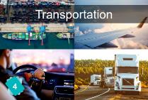
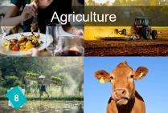

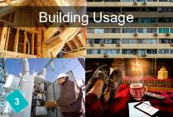
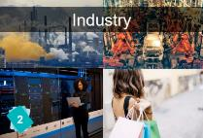
How did we achieve this?!
How did we
reduce our
GHG emissions?

Slide 38

A systemic transformation
What action had the
biggest impact?
+1.2°C
Actions must be
within our control!
Notes:
38

Slide 39
Pareto principle: 80/20
80% of the consequences
come from
20% of the causes
Notes:
39

Slide 40


2 types of actions
Easy, short term actions
to accelerate the transition
Ambitious, long term actions
to have the biggest impact
Notes:
40

Slide 41

Thank you

